Slide 1
Amazon EC2
Amazon Elastic Compute Cloud (Amazon EC2)
Secure and resizable compute capacity for virtually any workload

Slide 2
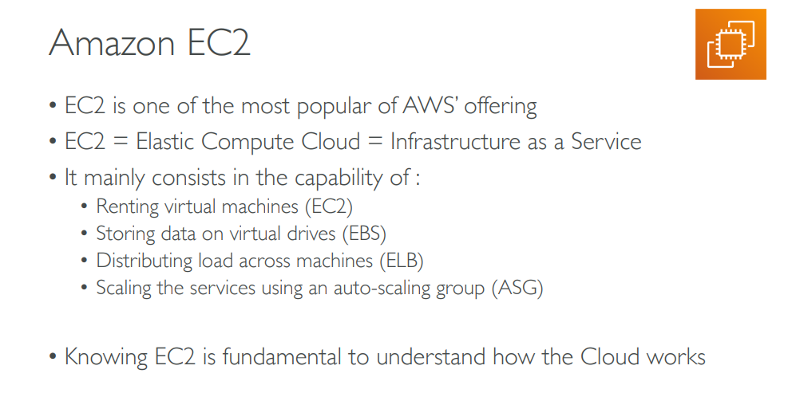

Slide 3
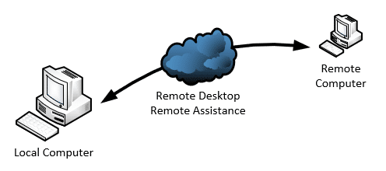

Slide 4
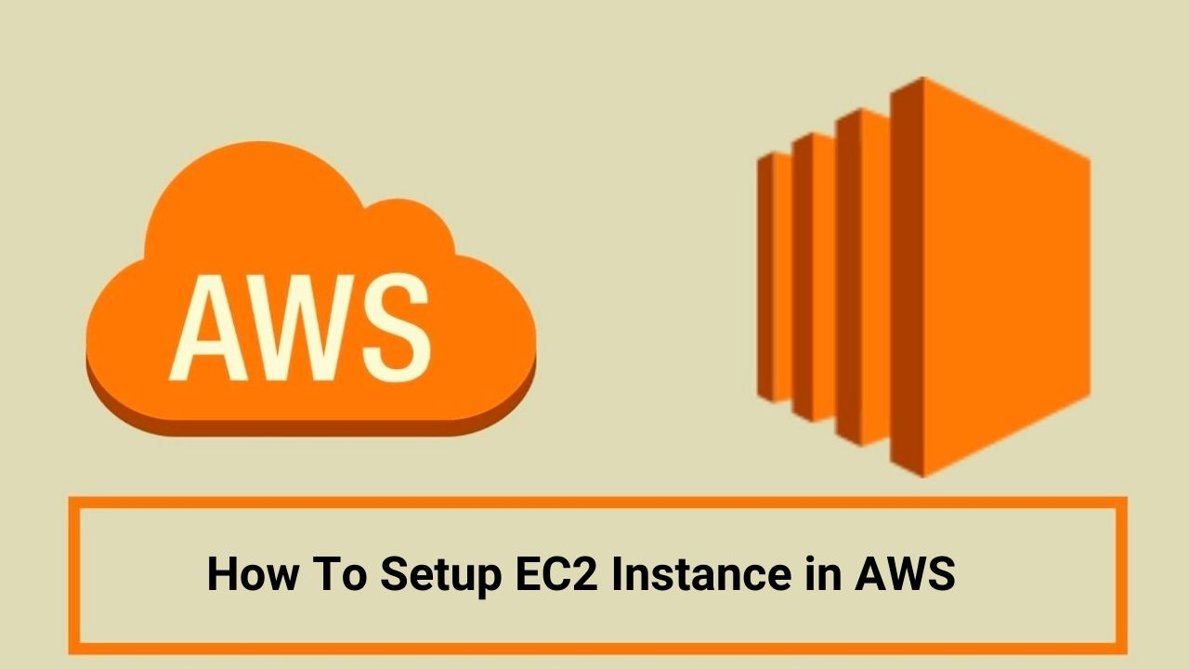

Slide 5
Steps to Configure AWS EC2
Step1 -Log in AWS Console
Step2- Launch Your EC2 Instance
Step3- Configure Your Instance
Step4- Connect to Your Instance
Step5- Instance Lifecycle

Slide 6
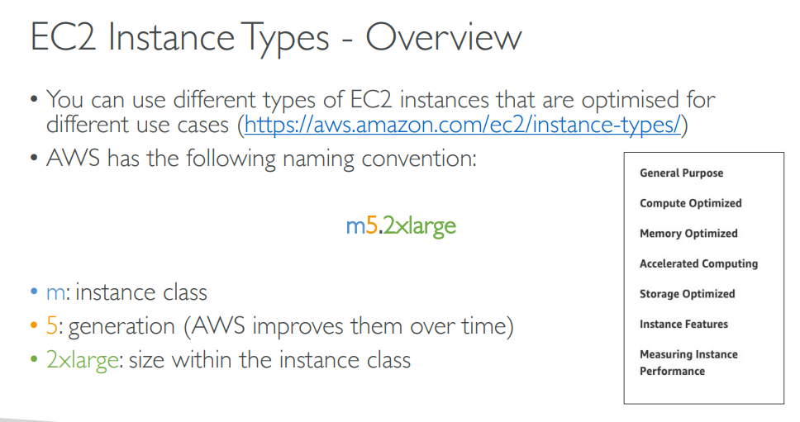

Slide 7
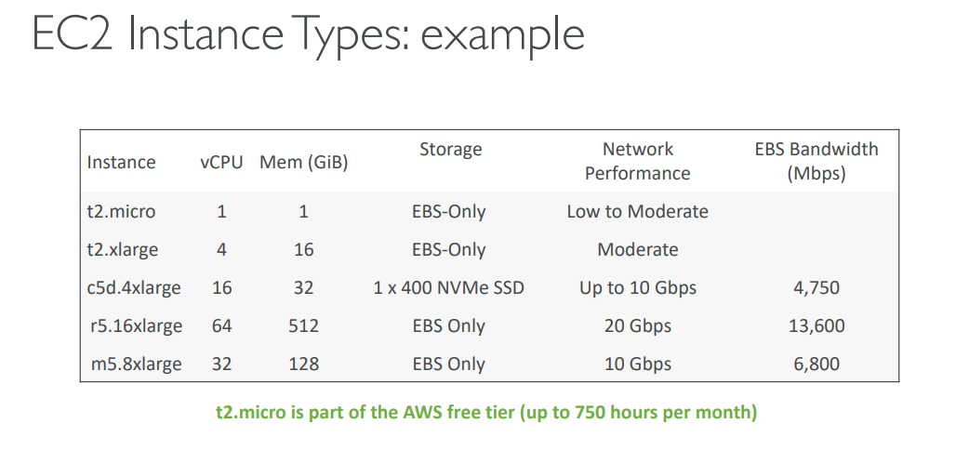

Slide 8
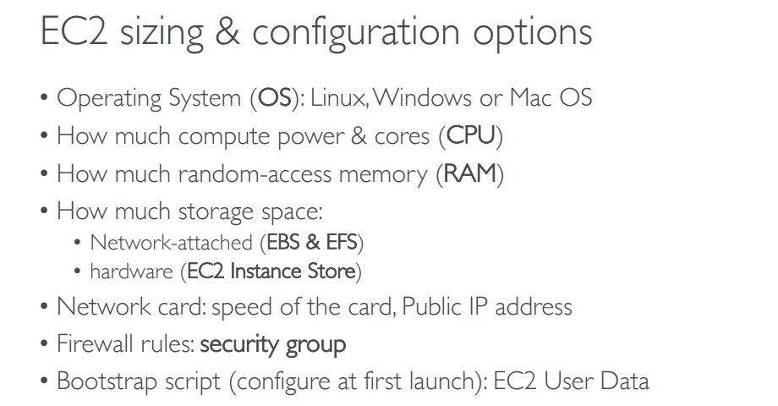

Slide 9
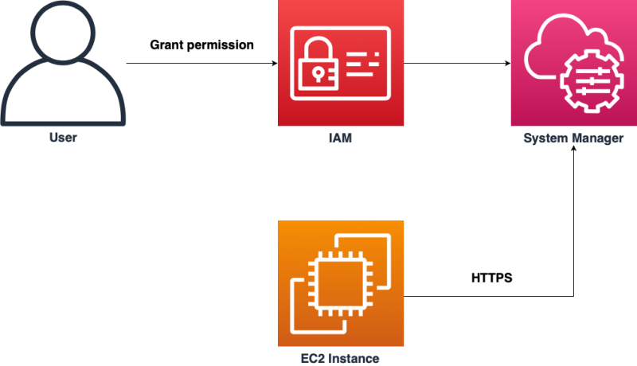
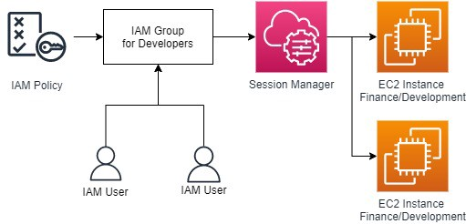
Single user or multiple user can access this Instance

Slide 10
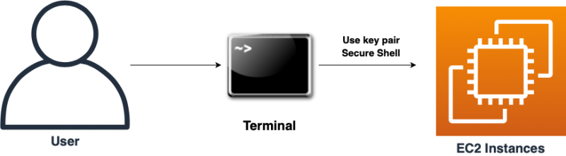
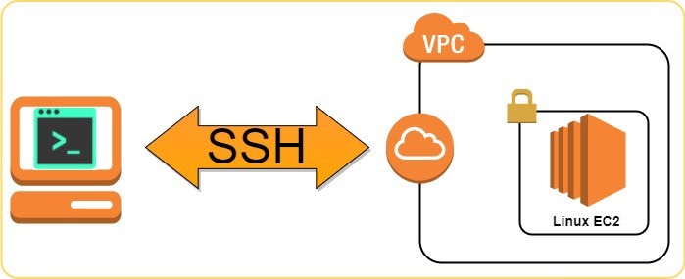
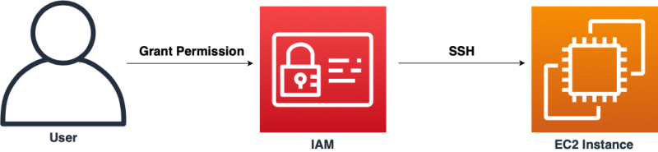

Slide 11
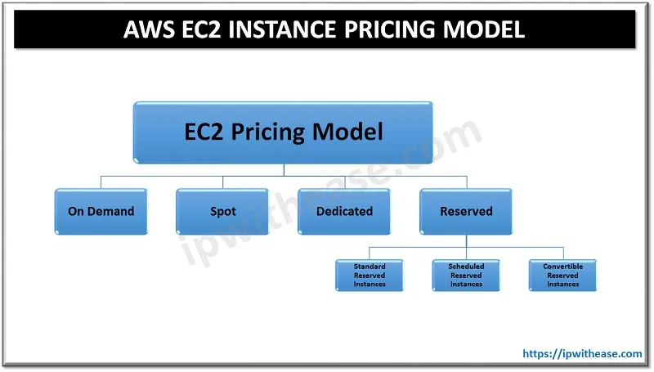

Slide 12
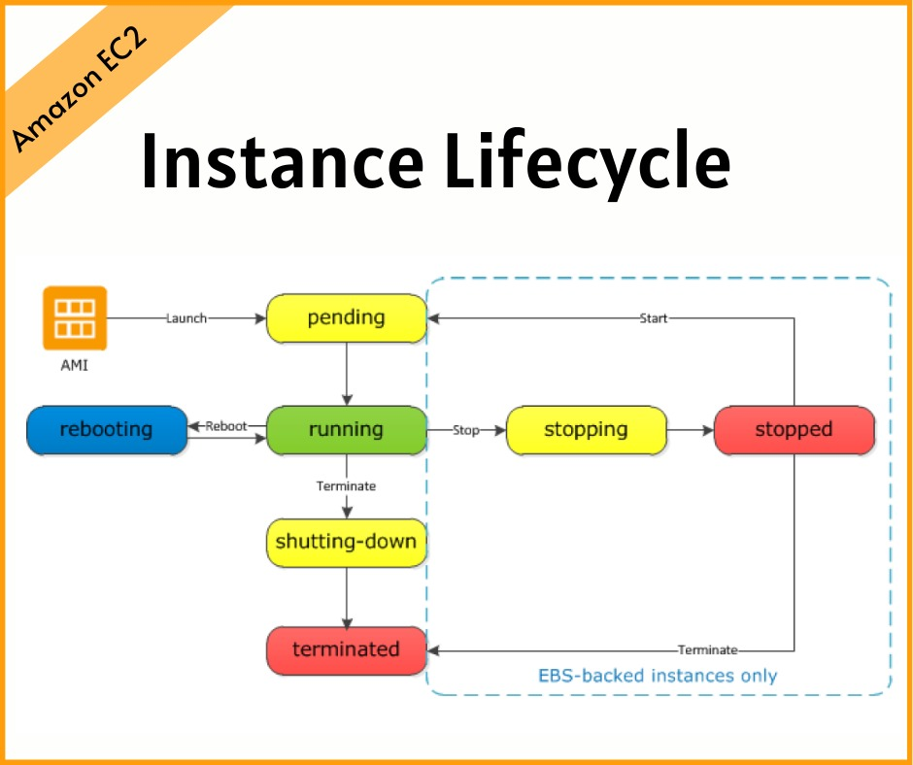

Slide 13
Demo of EC2

Slide 14
EC2 Section – Summary
EC2 Instance: AMI (OS) + Instance Size (CPU + RAM) + Storage + security groups + EC2 User Data
Security Groups: Firewall attached to the EC2 instance
EC2 User Data: Script launched at the first start of an instance
SSH: start a terminal into our EC2 Instances (port 22)
EC2 Instance Role: link to IAM roles
Purchasing Options: On-Demand, Spot, Reserved (Standard + Convertible + Scheduled), Dedicated Host, Dedicated Instance

